Slide 1
Cooling Below 1 K
J. G. Weisend II
www.europeanspallationsource.se
Winter 2025

Slide 2
Goals
Describe 3 methods for cooling below 1 K
  Subatmospheric ³He
  Dilution Refrigerators
  Adiabatic Demagnetization Refrigerators
Provide some examples of these techniques in use

Slide 3
Introduction
Why go below 1 K ?
There are basic scientific questions that require operating at these temperatures:
  Sensors for X-Ray and IR Astronomy
  Dark Matter Searches
  Fundamental condensed matter studies (superfluid ³He, solid He etc)
The cryogenic techniques for operating at these temperatures are essentially the same that we have seen already only more so:
  Greater attention to minimizing heat leaks
  Specialized sensors
What is very different is how we get to these temperatures.
  The various refrigeration cycles and methods we’ve discussed so far won’t get us there

Slide 4
Limits to Pumping on ⁴He
We can reduce the temperature of liquid helium by reducing its saturation pressure – but there is a limit.
The vapor pressure of the most abundant He isotope (⁴He) becomes very small below ~ 1.2 K so cooling below this temperature using this technique isn’t feasible
The solution is ³He !

Slide 5
³He
This is the other stable isotope of helium
Very rare < 0.1 ppm of He in nature
  However can be produced via radioactive decay of Tritium (³H)
³He is still very expensive and shortages have occurred driven by Homeland Security applications
Pumped ³He systems can provide cooling down to 200 – 300 mK
  Such systems always recycle the ³He and frequently use soption pumps employing activated charcoal
  Typical performance is up to 400 μW @ 300 mK for 6 hours
³He does become a superfluid below 2.65 mK but the explanation of the superfluid properties are very different than that of ⁴He superfluid (He II)
  In ³He the superfluid mechanism is similar to BCS theory in superconductors
    (Fermions vs. Bosons)

Slide 6
Dilution Refrigerators
These use a mixture of ³He/⁴He and take advantage of 3 physical effects:
Below 0.8 K a ³He/⁴He mixture will spontaneously separate into a ³He rich zone atop a heavier ⁴He rich zone
It requires energy to move a ³He atom from the ³He rich zone to the ⁴He rich zone. This energy reduces the temperature of the ³He/⁴He mixture
Below 1 K the vapor pressure of ³He is much higher than that of ⁴He Thus, pumping on the ⁴He rich side will preferentially remove ³He atoms.
Pumping on the ⁴He rich side of the mix causing ³He atoms to leave. In order to maintain equilibrium ³He atoms will move from the ³He rich zone to the ⁴He rich zone. This results in net cooling of the mixture and of whatever it is tied to.

Slide 7
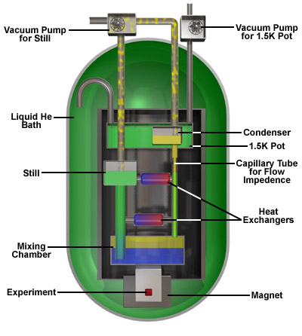
Schematic of Typical Dilution
Refrigerator
From NHMFL/ FSU Website
Note Magnet is not part of DR

Slide 8
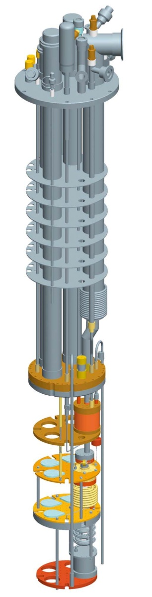
Dilution Refrigerators are Commercial Devices
Oxford Instruments
Base temperature (no load) 7 mK
> 400 μW @ 100 mK
Janis Research
Base temperature (no load) 12 mK
200 μW @ 100 mK
Note:
1) Small thermal capacities
2) Multiple radiation shields &
thin wall tubes for low heat leak

Slide 9
Cryogenic Dark Matter Search
Test System
Note Multiple
Temperature
Stations
& Nested Shields
Based on Existing
Oxford DR

Slide 10
Adiabatic Demagnetization Refrigerator
This technique makes use of two physical effects
  In a reversible system with no heat transfer the total entropy remains constant
    Q = TdS (second law)
  When exposed to a magnetic field, the magnetic regions of a paramagnetic material become more ordered and thus lower in entropy
In effect, the ADR transfers entropy between the random thermal vibrations of the paramagnetic material and the alignment of the magnetic regions.
Note that in order for this to work, the entropy in the magnetic ordering and that of thermal vibrations must be about the same. Thus this only works below ~ 2 - 4 K
An ADR typically consists of a paramagnetic solid or “salt pill”, magnet, heat sink ( typically a <2 K), a thermal switch and item to be cooled

Slide 11
ADR Process
The ADR process is cyclic
  Step 1: The thermal switch is off and the magnet is turned on. As the field is increased, the magnetic regions in the solid start to align and the entropy of these regions decreases. In order to keep the overall entropy constant, the entropy in the thermal vibrations increases ( and thus the temperature increases)
  Step 2: Next the thermal switch is connected and heat is transferred from the solid to the heat sink while the magnetic field is held constant. This reduces the temperature of the solid back to near its starting point.
  Step 3: The thermal switch is now closed isolating the solid and the magnetic field is now reduced. This is the adiabatic demagnetization portion of the cycle. As the magnetic field is reduced the paramagnetic regions become more disordered and absorb entropy from the thermal vibrations resulting in a cooling of the paramagnetic material and of the object being cooled.

Slide 12
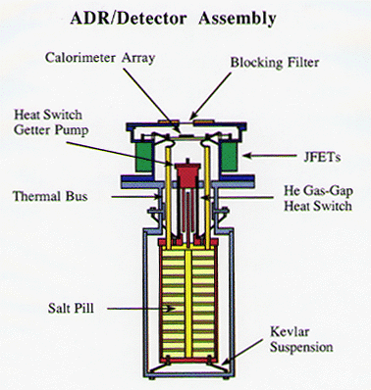
Example of an ADR System
From NASA Goddard
Used in XRS Satellite
60 mK for 30 hours ( 5 μW)
Thermal Sink is 1.3 K He Bath
Note that ADRs are very popular in space systems as Dilution Refrigerators are difficult to use in Zero g

Slide 13
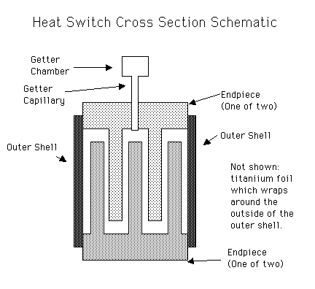
ADR Components
Paramagnetic Salt Pill materials
  Gadolinium Gallium Garnet (GGG)
  Ferric Ammonium Alum (FAA)
Heat Switches
  Gas gap – the He gas provides the thermal contact. The switch is opened by absorbing the gas into a getter material This is done by allowing the getter to cool down. Heating the getter back up releases the gas and “closes the switch”
Magnets
  The ADR magnets are small superconducting solenoids at roughly 1 – 5 T
Courtesy
NASA Goddard

Slide 14
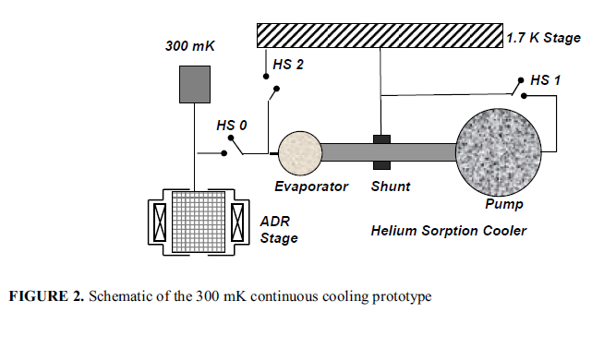
Continuous Cooling
Both ADRs and ³He sorption coolers are batch cooled systems.
Continuous cooling may be achieved by putting such systems in parallel
From “ 300 mK Continuous Cooling, Sorption ADR System”
Duval et al. Adv. Cryo Engr. Vol. 55 (2010)

Slide 15
Can We Go Even Colder?
Nuclear Demagnetization Refrigeration
  Essentially the same as ADR but aligns magnetic dipoles in the nucleus
  This can get us down into the μK to 100s of pK region but require higher magnetic fields and a starting point (heat sink) in the mK range.

